Slide 1


MgO unit cell configurations to compute
Joel Tan

Slide 2
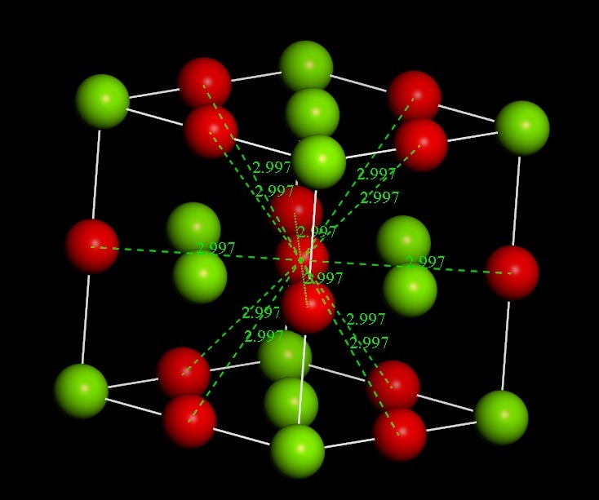
Basic Definitions
: Mg
: O
N = no. of defects to be formed

Slide 3
N = 0

Slide 4
N = 1
: O vac

Slide 5
N = 2

Slide 6
N = 3

Slide 7
N = 3

Slide 8
N = 3

Slide 9
N = 3

Slide 10
N = 4

Slide 11
N = 4

Slide 12
N = 4

Slide 13
N = 4

Slide 14
N = 4

Slide 15
N = 4

Slide 16
N = 4

Slide 17
N = 4

Slide 18
N = 4

Slide 19
N = 5

Slide 20
N = 5

Slide 21
N = 5

Slide 22
N = 5

Slide 23
N = 5

Slide 24
N = 5

Slide 25
N = 5

Slide 26
N = 5

Slide 27
N = 5

Slide 28
N = 5

Slide 29
N = 5

Slide 30
N = 5

Slide 31
N = 5

Slide 32
N = 5

Slide 33
N = 6

Slide 34
N = 6

Slide 35
N = 6

Slide 36
N = 6

Slide 37
N = 6

Slide 38
N = 6

Slide 39
N = 6

Slide 40
N = 6

Slide 41
N = 6

Slide 42
N = 6

Slide 43
N = 6

Slide 44
N = 6

Slide 45
N = 6

Slide 46
N = 6

Slide 47
N = 6

Slide 48
N = 6

Slide 49
N = 6

Slide 50
N = 6

Slide 51
N = 6

Slide 52
N = 6

Slide 53
N = 6

Slide 54
N = 6

Slide 55
N = 6

Slide 56
N = 6

Slide 57
N = 6

Slide 58
N = 6

